Slide 1
APS Athletics

Slide 2
APS Athletics
Expectations:
1) Database for all athletes at the high school
2) Significant Injuries
a) Detailed information on concussion

Slide 3
https://www.swol123.net

Slide 4
APS Athletics
Go to Sportsware website: www.swol123.net
Type in e-mail and password:
Password and e-mail are set for the athletic trainer
1) General information of athlete
2) Insurance and emergency contact
3) Physical and related paper confirmation
4) Injury data on significant injuries and concussion follow-up
2) Athletic Director should be able to use school access and at least view information as needed.

Slide 5
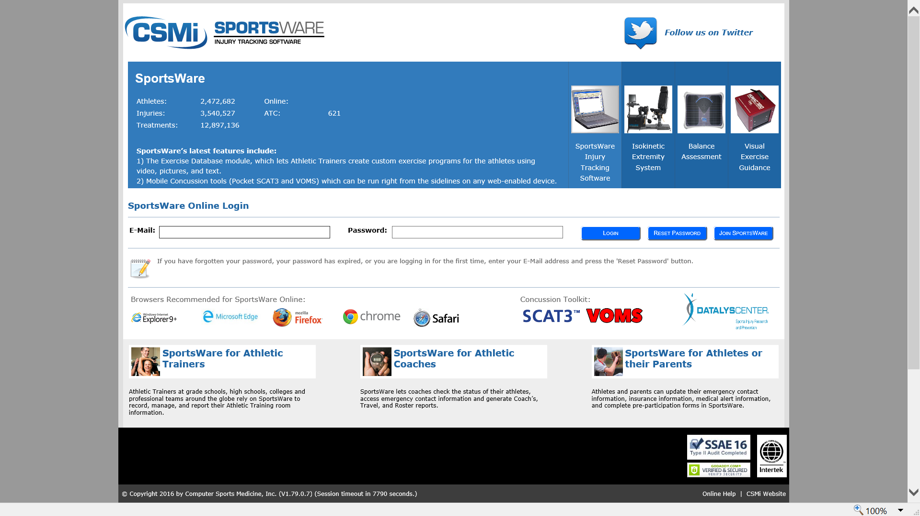

Slide 6
APS Athletics
Sign in takes you to Dashboard:
Icons at top of page will be used to navigate the system
Running athlete Icon
General information for athlete
Used to develop database
Ambulance Icon
Used to develop all significant injuries
Concussion Icon
Used to record concussion progress

Slide 7
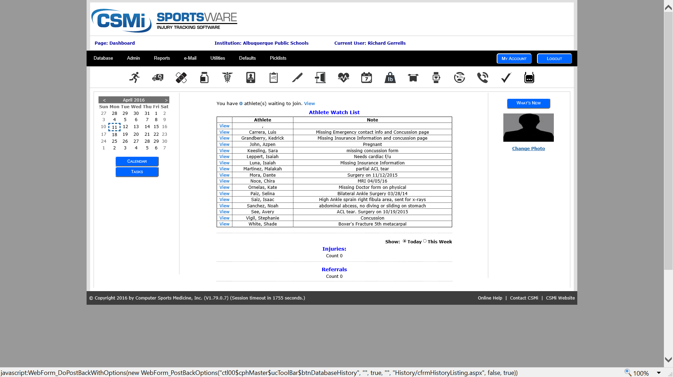

Slide 8
APS Athletics
Click Running Athlete Icon:
General athlete page will show be displayed
Add new athletes
Update current athletes
If a athlete needs to be deleted type “delete” into last name box.
APS Athletics will purge

Slide 9
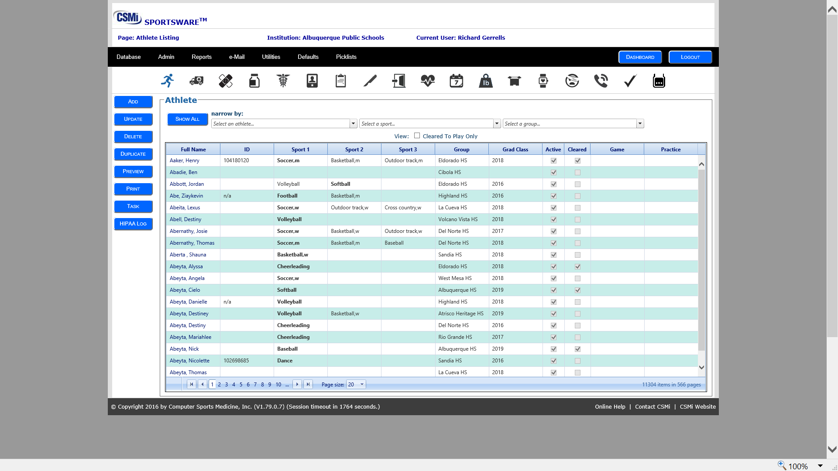

Slide 10
Database Entry: New and Returning Athlete’s
APS Athletics
From Athlete Page: (Running athlete icon)
Using the Buttons on the left side of page:
New Athlete
click on ADD athlete
Fill in information required
Returning Athlete
Select athlete from database
-- Using top column type in athlete
Click on highlighted athlete
Update as needed:

Slide 11
APS Athletics
Database Information
General Box
Name – First and Last Capitalize first letter of each only
School ID#
Class—Enter Graduation/last year of eligibility
Gender-- Male / Female
Birth date: mm/dd/yyyy

Slide 12
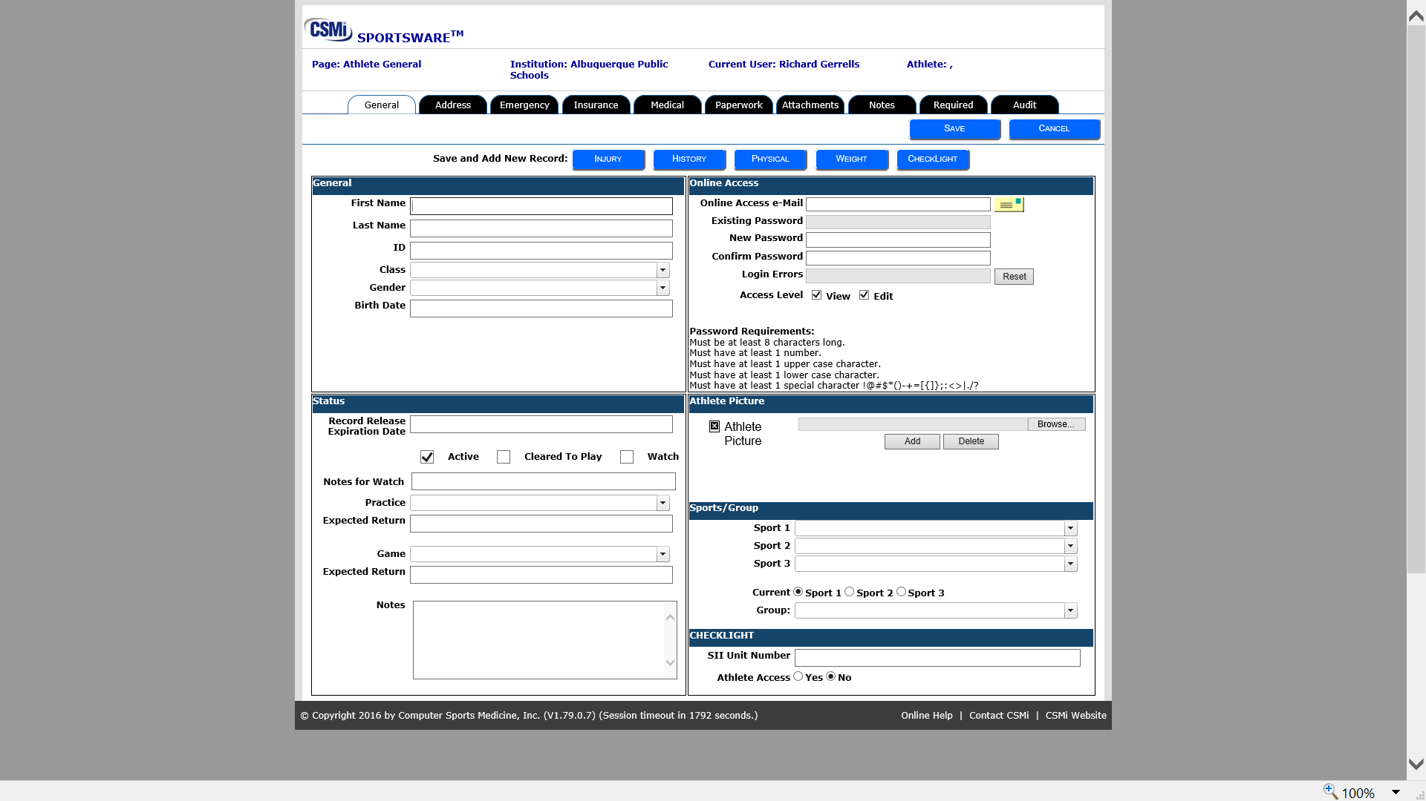

Slide 13
APS Athletics
Status Box:
Can be used as needed:
Allows for keeping people active or not, Clear, notes for practice status and game status.
General notes
Online Access ----Not in use at this time
Athlete Picture---Not in use at this time

Slide 14
APS Athletics
Sports/Group
Sports---List sports from pull down menu---
Group---Group will be your school (make sure you are putting in your school in this area, otherwise all schools will view your athlete)
Checklight ---Not in use at this time

Slide 16
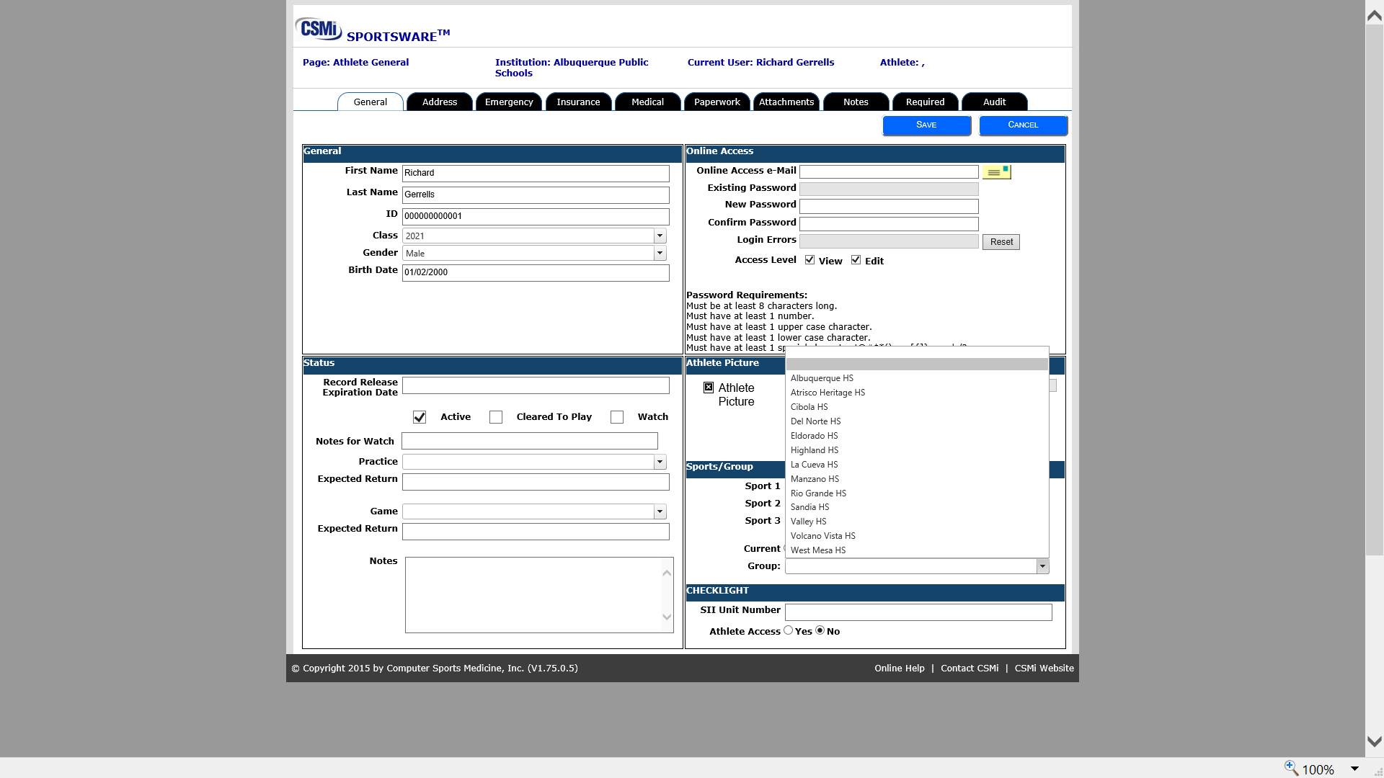

Slide 17
APS Athletics
Address Tab:
List only the address used as official address for your school
Primary parent contact number
Emergency Contact
Primary emergency person/relationship/contact information
Secondary as needed
Insurance Tab
Company –Site name only information needed. (other optional)

Slide 18
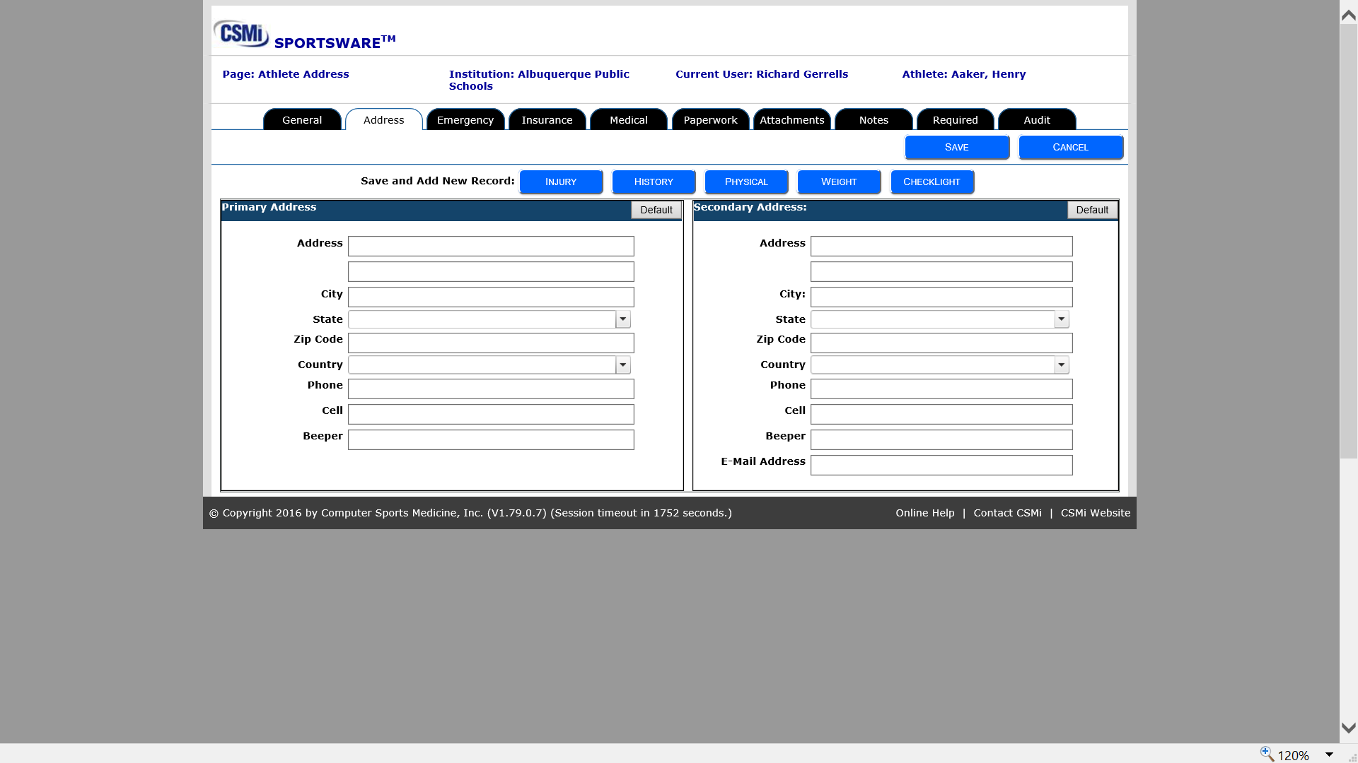

Slide 19
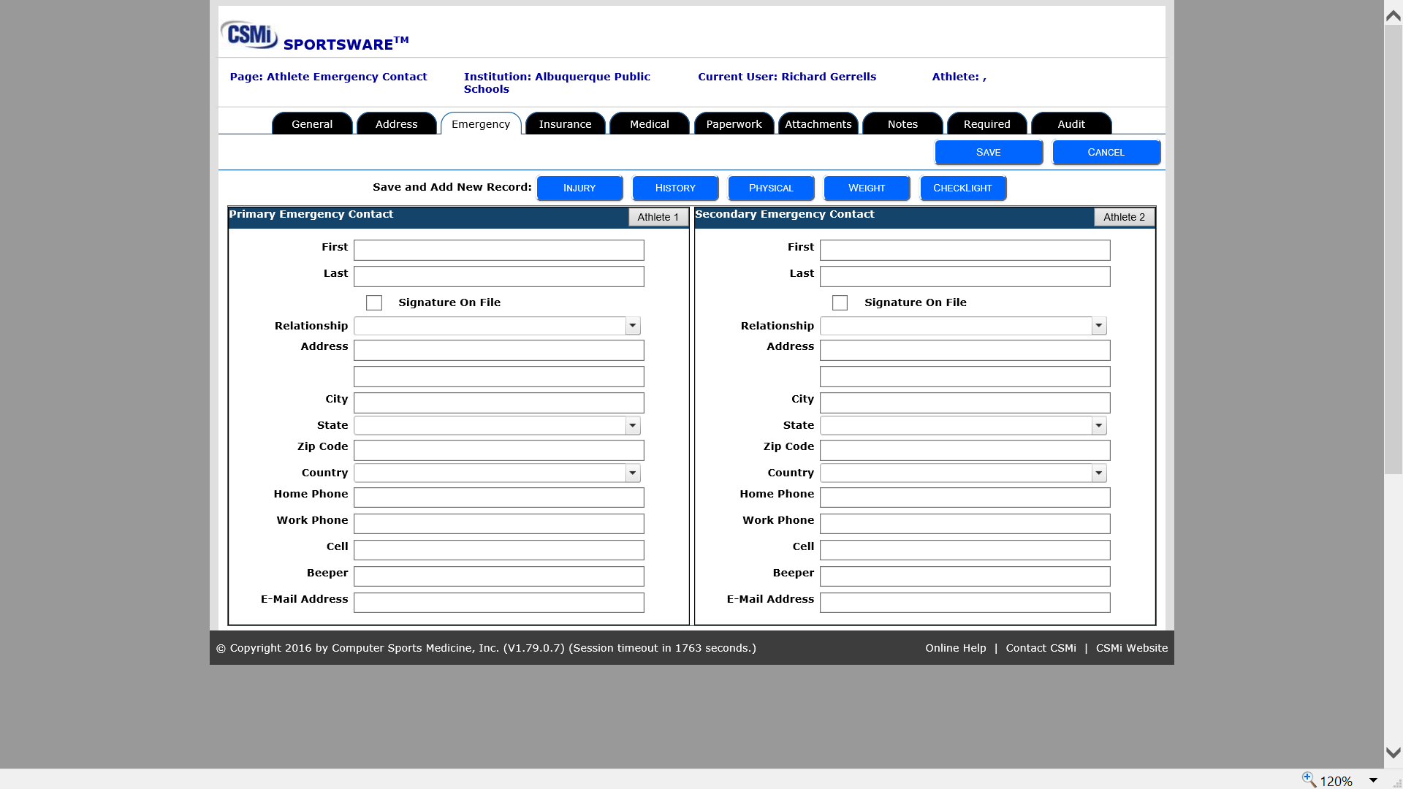

Slide 20
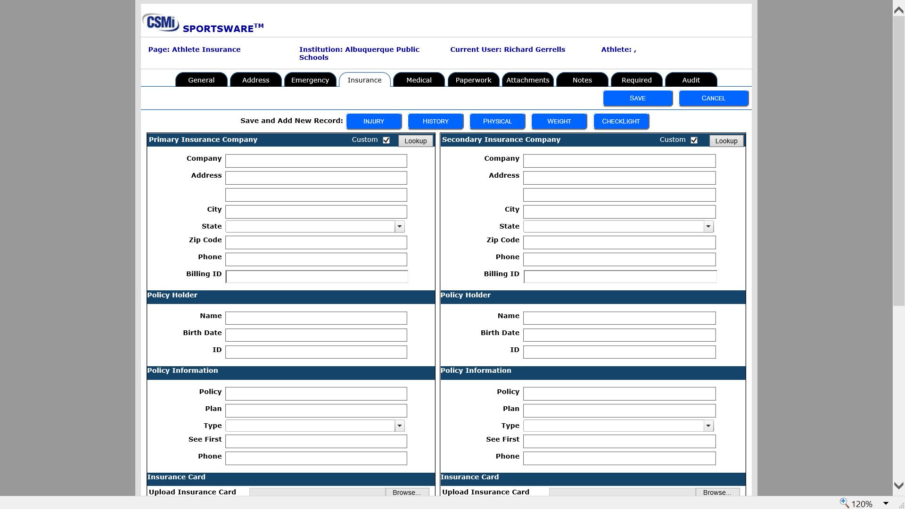

Slide 21
APS Athletics
Medical Tab
List any medical conditions athlete may have that need to be aware of
Paperwork
Since we currently require hard copies on most paperwork,
Enter the date you received the cleared the paperwork from the athlete
Physical Exam Enter date you received
Medical History Enter date you received
Concussion Cleared Enter date you received
School Insurance Enter date you received

Slide 22
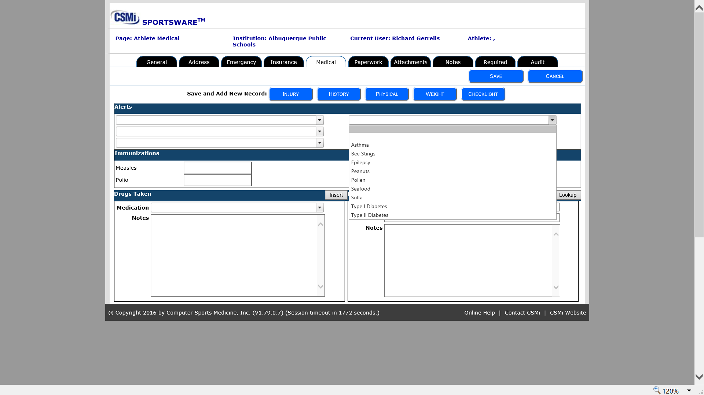

Slide 23
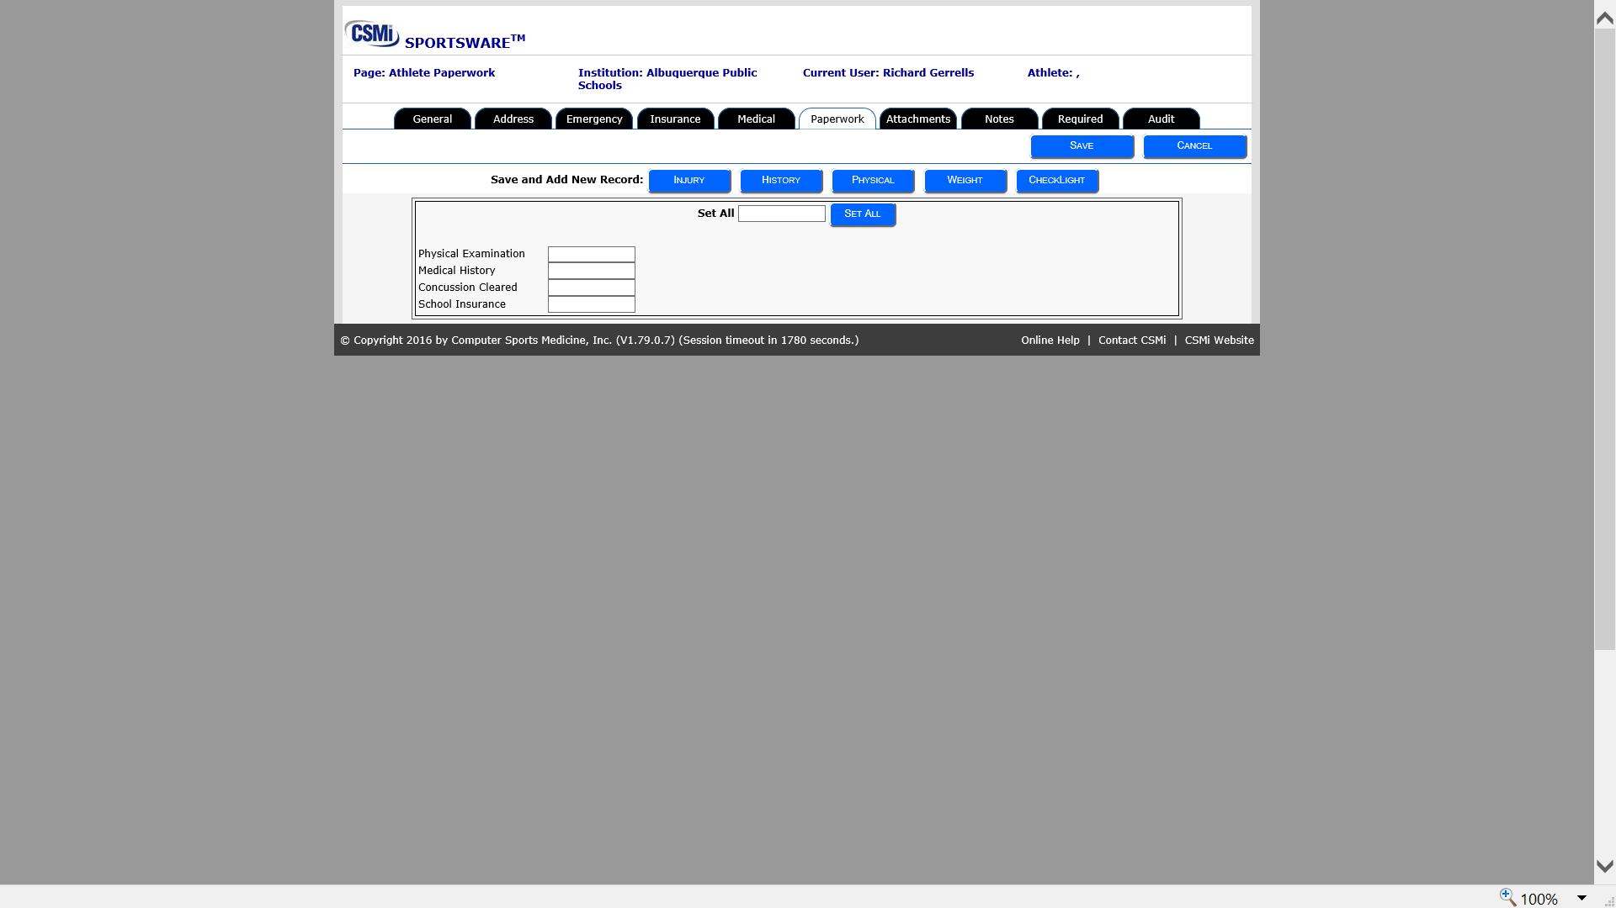

Slide 24
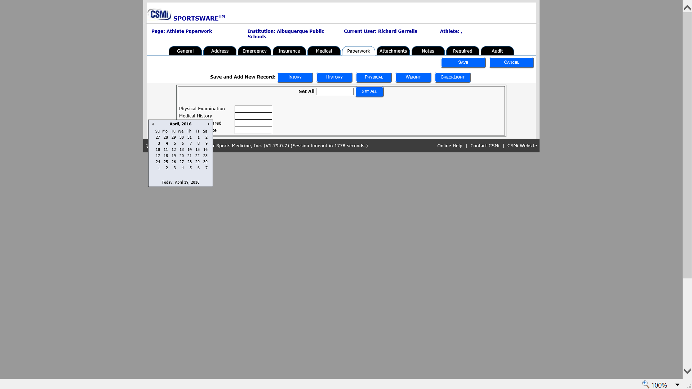

Slide 25
APS Athletics
Sportsware Implementation:
Injury Data
IT IS THE EXPECTATION THAT ALL ATHLETIC INJURIES DESIGNATED AS SIGNIFICANT WILL BE ENTERED INTO THE DATABASE

Slide 26
APS Athletics
Significant Injuries:
All injuries/Illnesses that results in a prolonged period of time loss for activity are to be considered----
Including at least injuries listed:
1) All Concussion type injuries (Will require addition step in data process)
Muscular/Skeletal injuries with prolonged loss of activity
Neck and Back injuries
Pulmonary Conditions
Serious Illnesses with prolong lost of time from sports
Heat conditions resulting in any time lost

Slide 27
APS Athletics
Begin in Injury Database: (Ambulance Icon)
Select an Athlete from database in narrow by “select an athlete”
Once correct athlete is shown Click on left button Add
General Injury Page
Status section:
Injury Date, Time, Sport.
Return to page at end of injury:
Complete Ret to Play (Days out will auto fill)
Closed date: (When athlete has completed all rehab)
Update existing injury
Injury Database: (Ambulance Icon)
Select an Athlete from database in narrow by “select an athlete”
Once correct athlete is shown Click on left button update

Slide 28
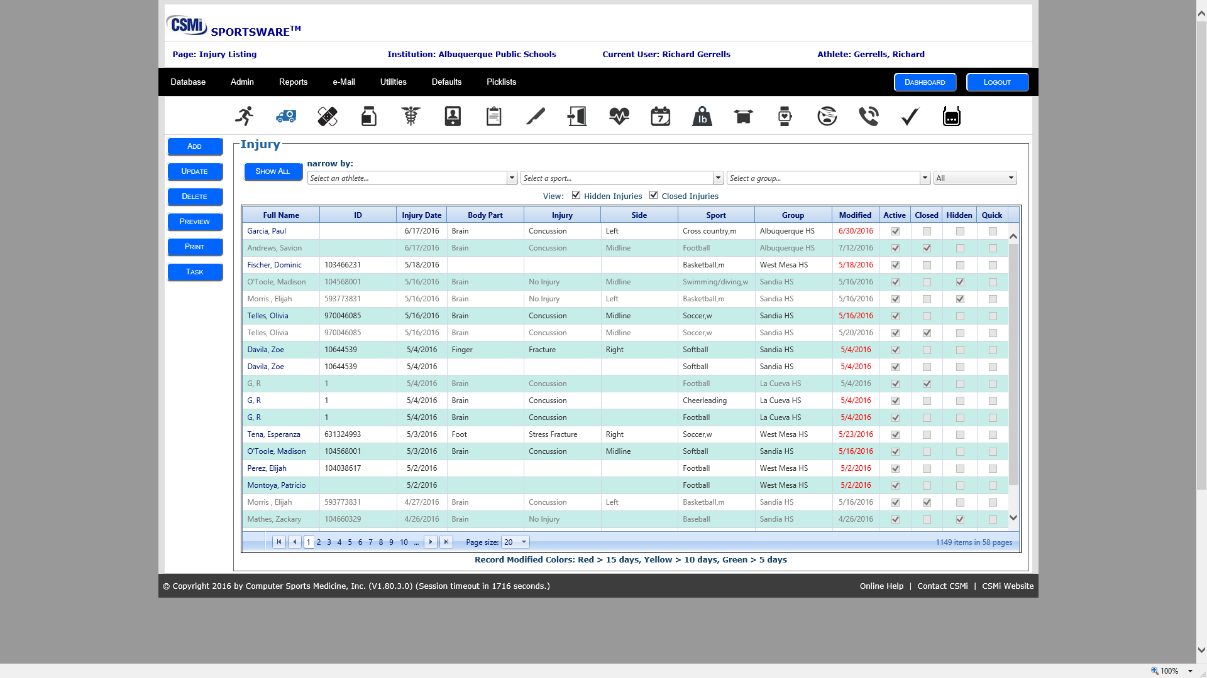

Slide 29
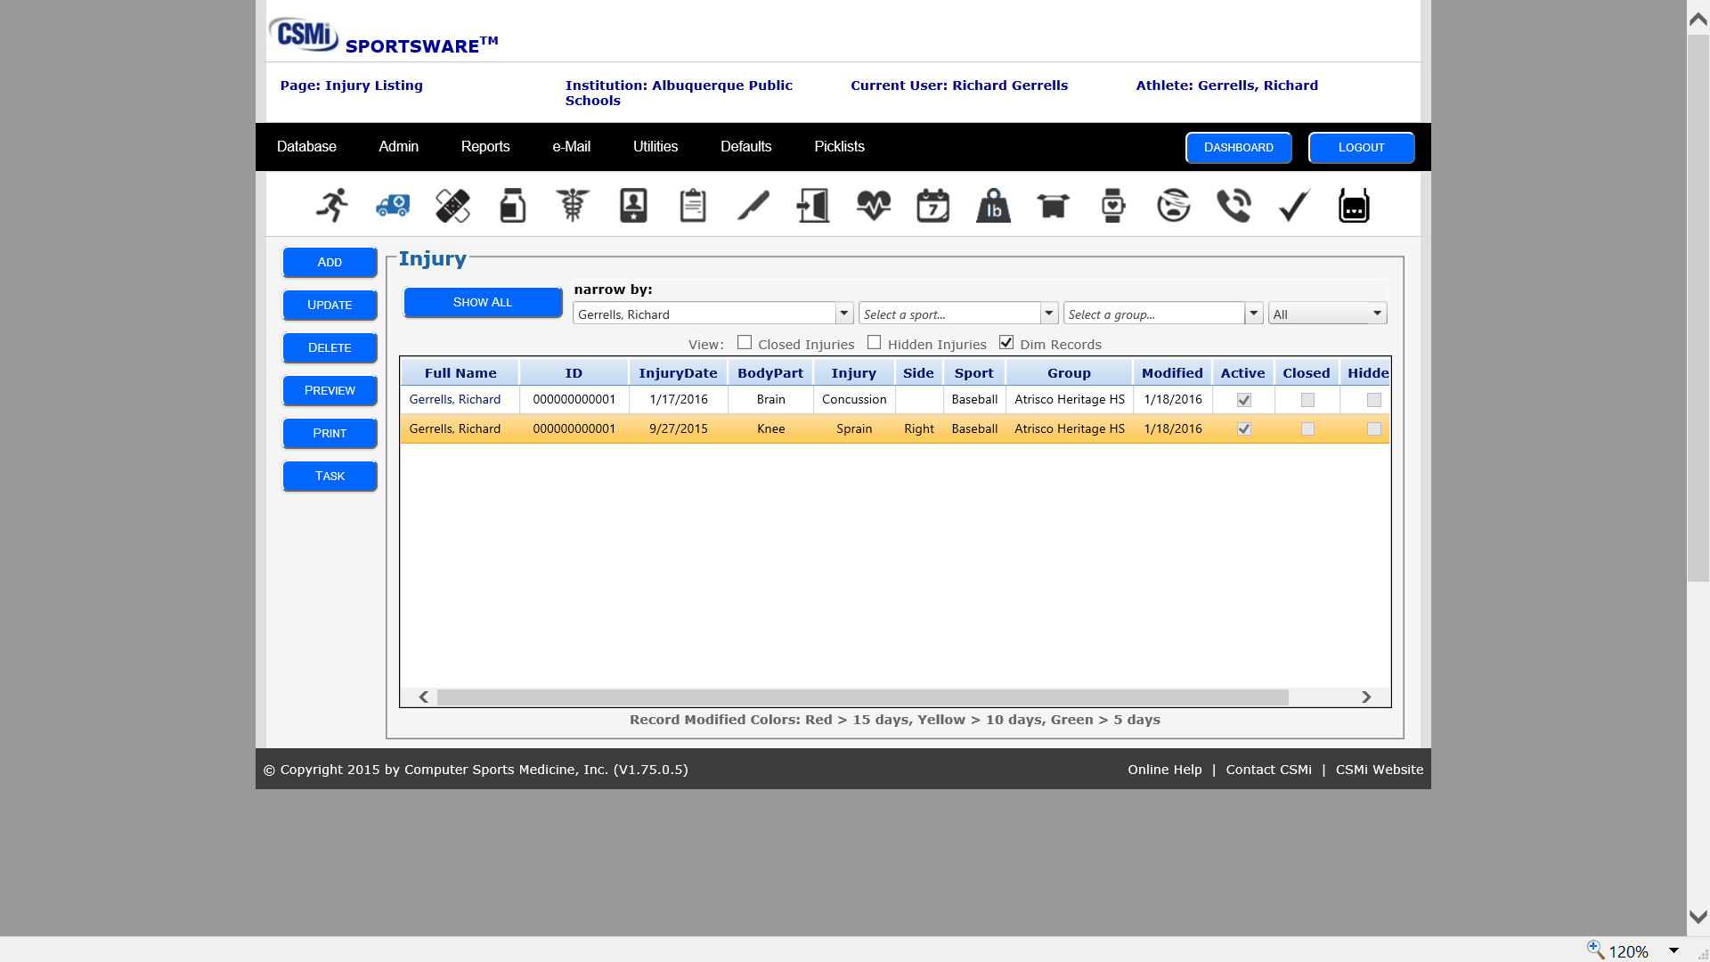

Slide 30
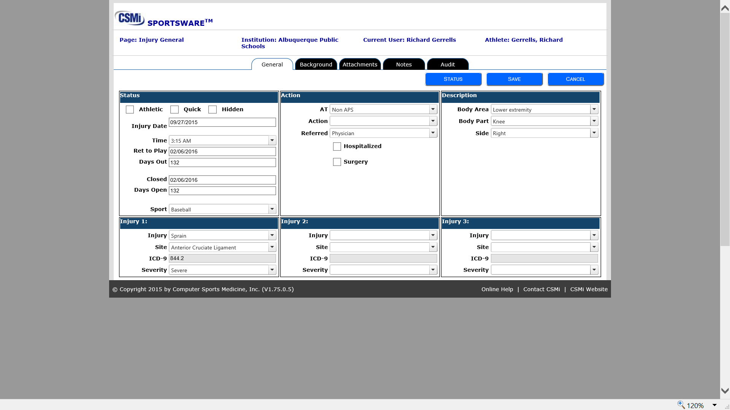

Slide 31
APS Athletics
Action Box
Completed by the home high school athletic trainer.
Athletic Trainer involved
Action description
Referred (Hospitalized) (Surgery)
Description
Body Area (pull down menu that fits best)
Body Part (pull down menu that fits best)
Side (As applies)
Injury (as evaluated) If doctor referred-returned diagnosis
Site(as evaluated) If doctor referred-returned diagnosis
Severity(as evaluated) If doctor referred-returned diagnosis

Slide 32
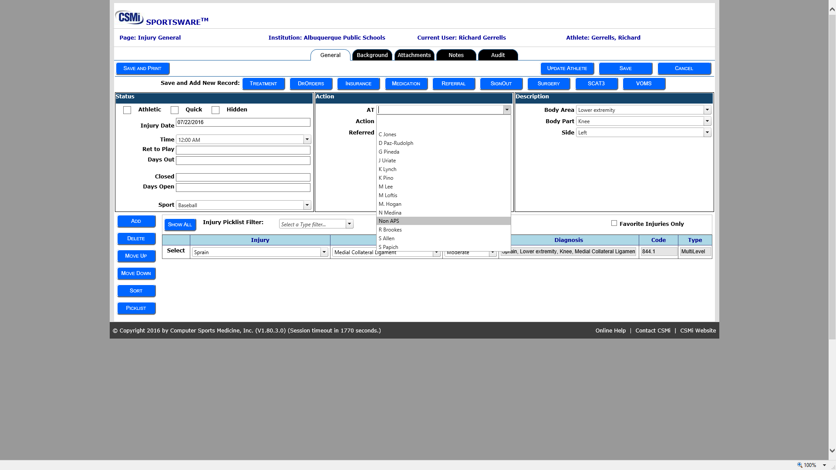

Slide 33
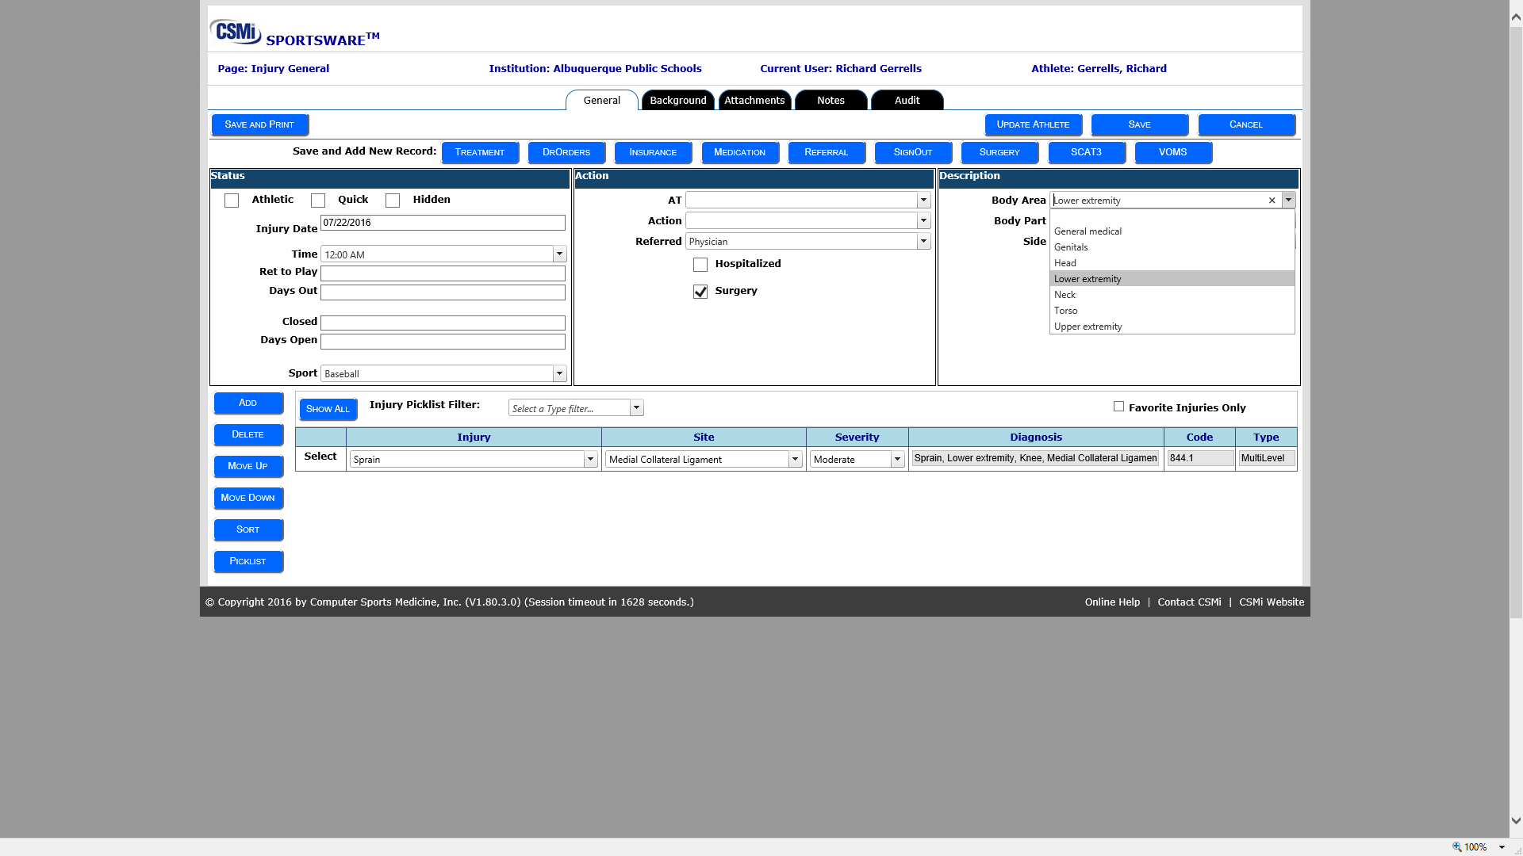

Slide 34
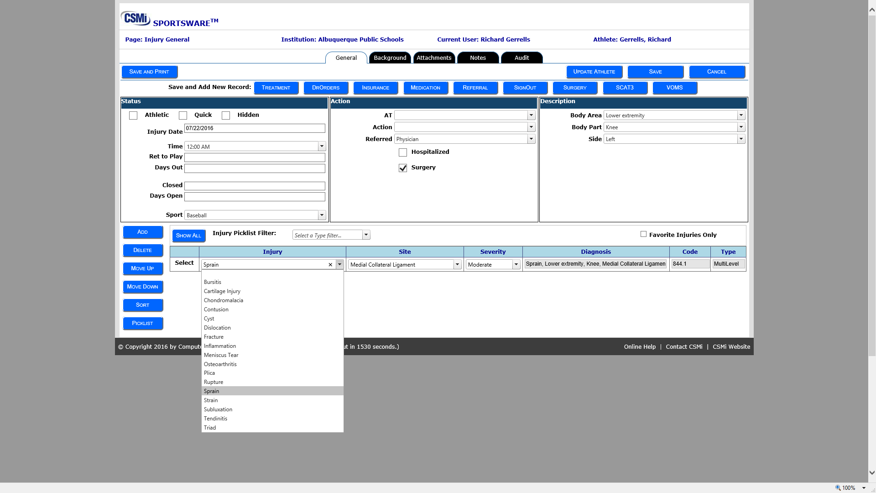

Slide 35
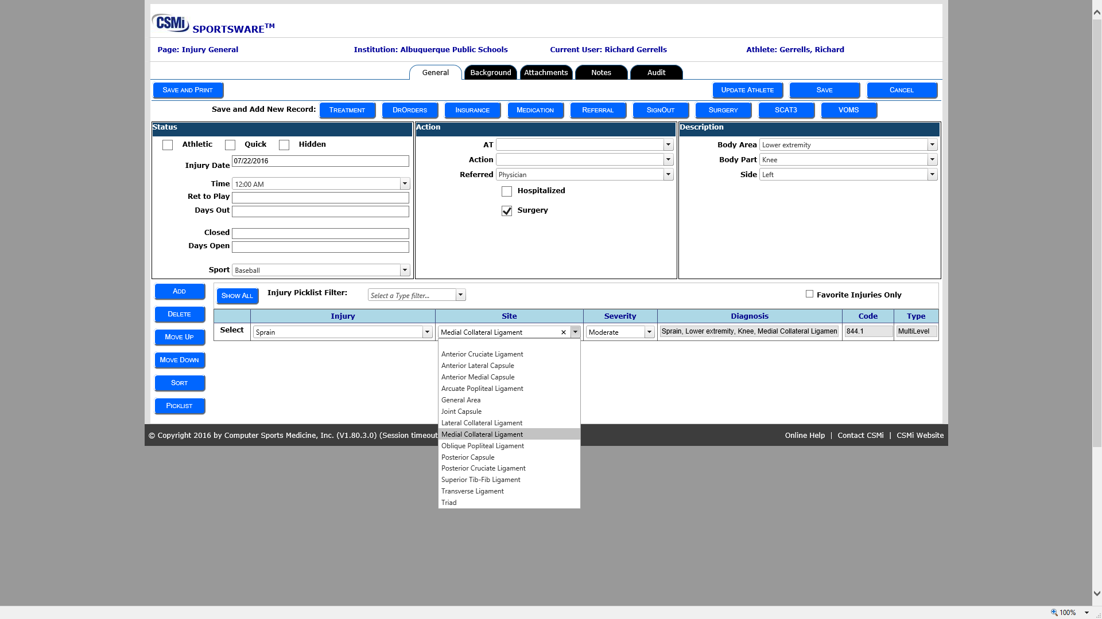

Slide 36
APS Athletics
APS Athletics
Background:
This information will be useful for all to look for trends in injuries that we need to identify for possible issues.
If we are getting a large number of severe knee injuries, or other possible trends.
Information should be entered to the best ability and knowledge of the situation. (May have played five positons at a freshman football game) and you are not sure which was the correct at time of injury.
May not remember or have known surface condition
Best of your ability (The closer you are the better your data to show coaches later)

Slide 37
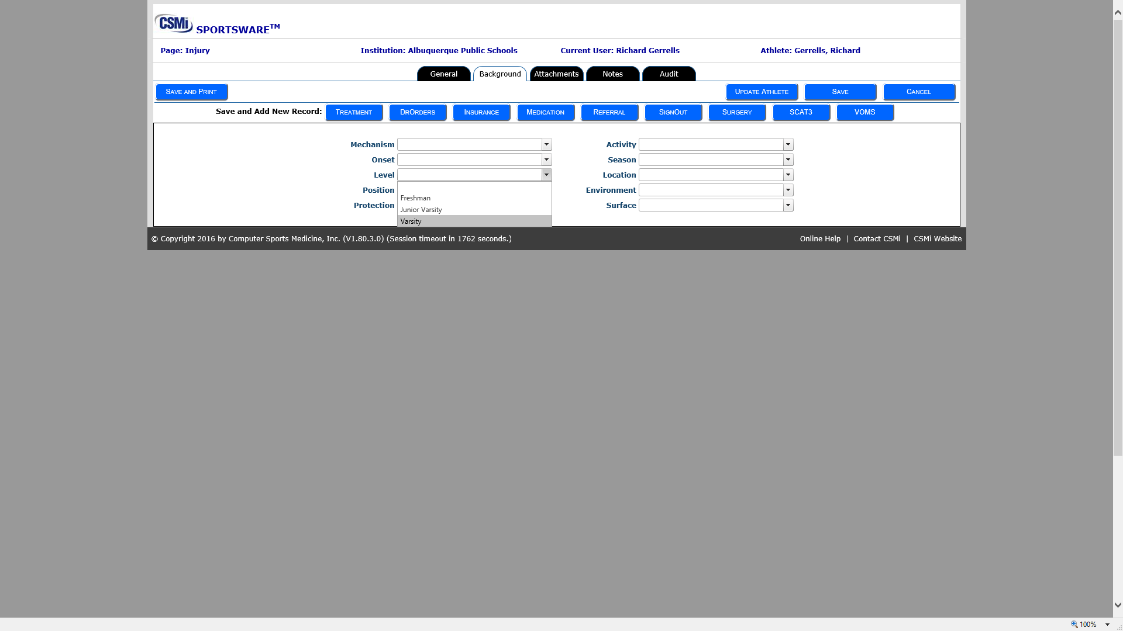

Slide 38
APS Athletics
Notes:
Section allows you to record of action:
SOAP notes

Slide 39
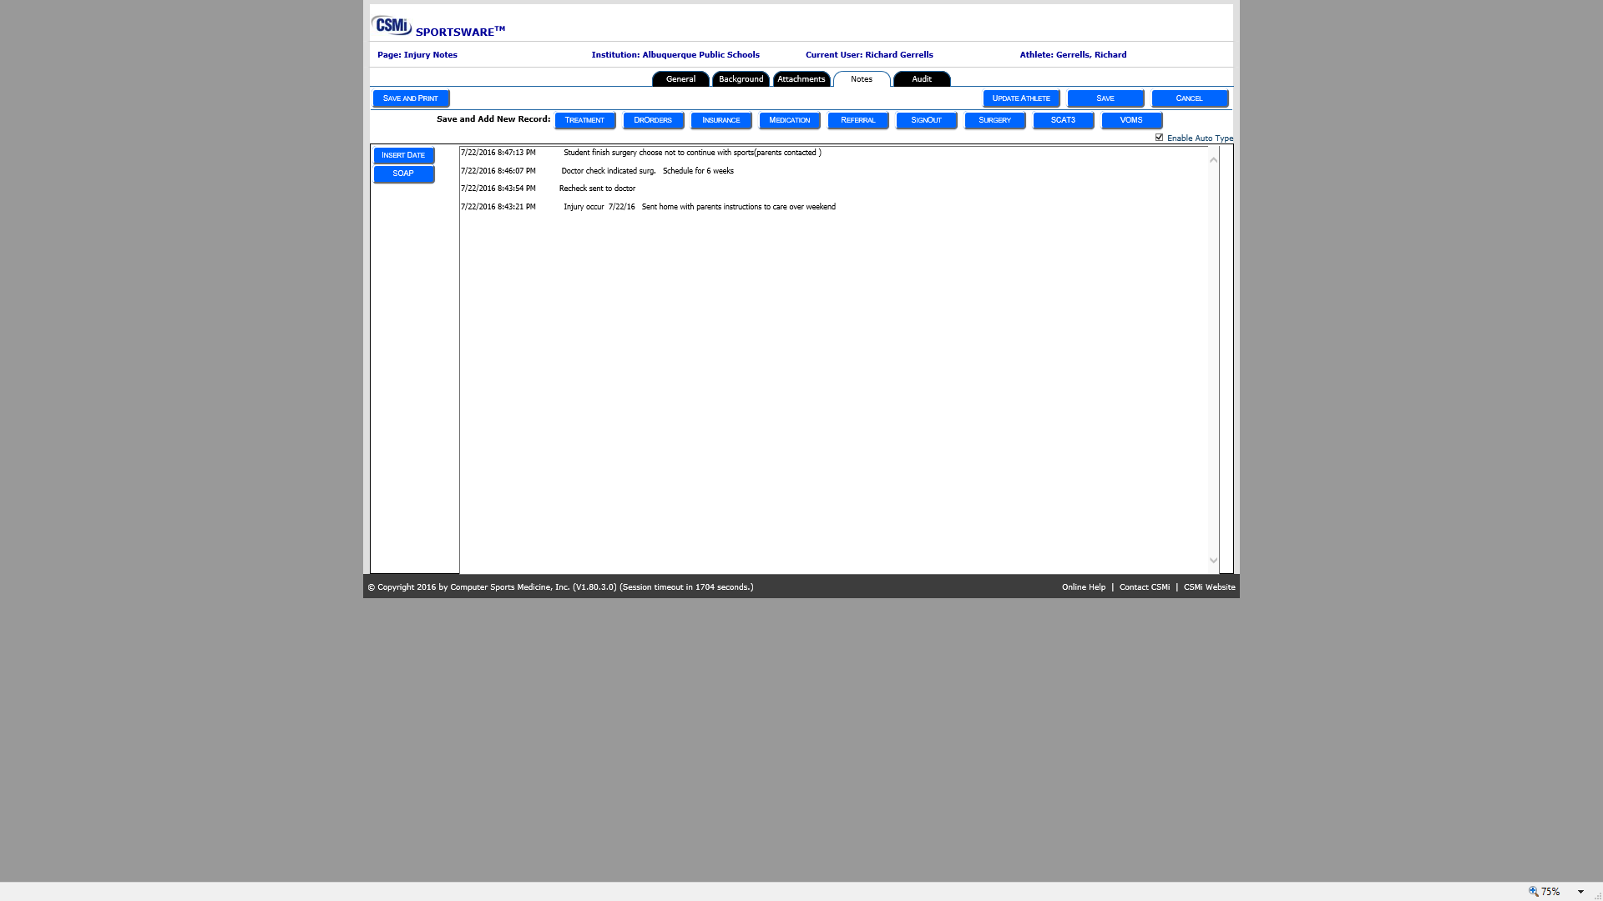

Slide 40
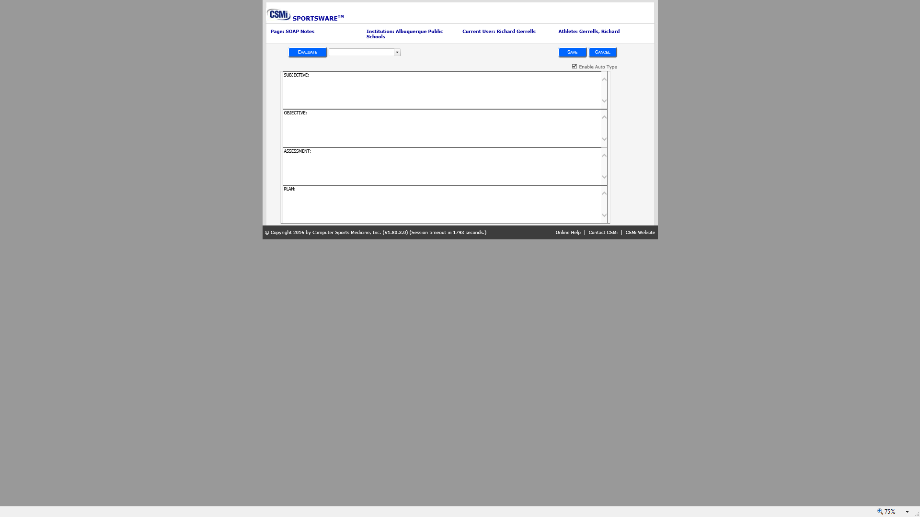

Slide 41
APS Athletics
Enter Concussion Data
Concussion Injuries are entered through the Injury Icon(Ambulance)
Enter information as with all injuries
Concussion specific data entry
To record specific information on Concussion two options are being allowed to give entry freedom of what works most appropriate for yourself.
Option 1 Hard copy data to SWOL
Option 2 SWOL only

Slide 42
APS Athletics
Option 1 Hard copy to SWOL
Hard copies are completed with each step.
Software entries
Initial injury with complete evaluation transferred to SWOL
SOAP note section for daily updates transferred to SWOL
Final evaluation and closed dates recorded on SWOL database
Other days and information recorded on hard copy.
(Please note instruction as to where information is and keep as medical records for required period needs to be indicated.)

Slide 43
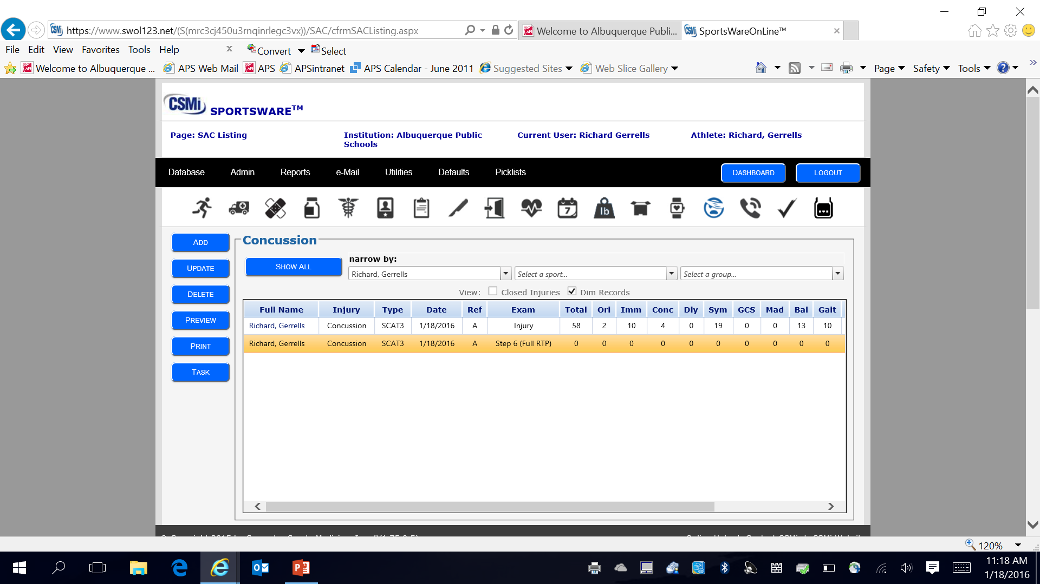

Slide 44
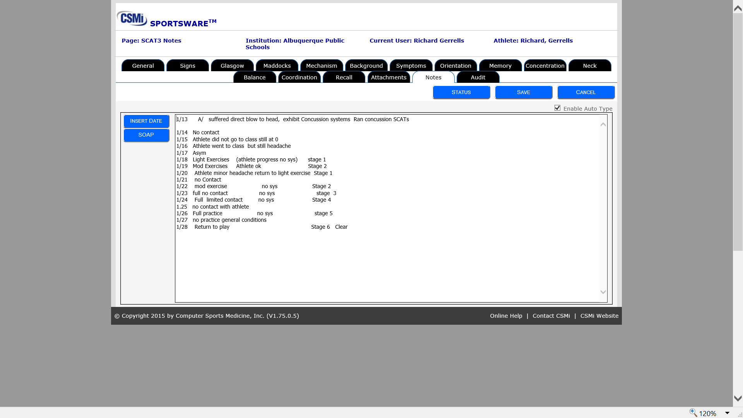

Slide 45
APS Athletics
Concussion Option 1 Steps
Once injury has been recorded in injury sheet
Click on Tab at top of page SCAT3
Page up will be Select SAC Questions---
Click on Add SAC or SCAT3 button
Page up will be SAC General-----
Add Examiner and Exam to information provided on this page.

Slide 46
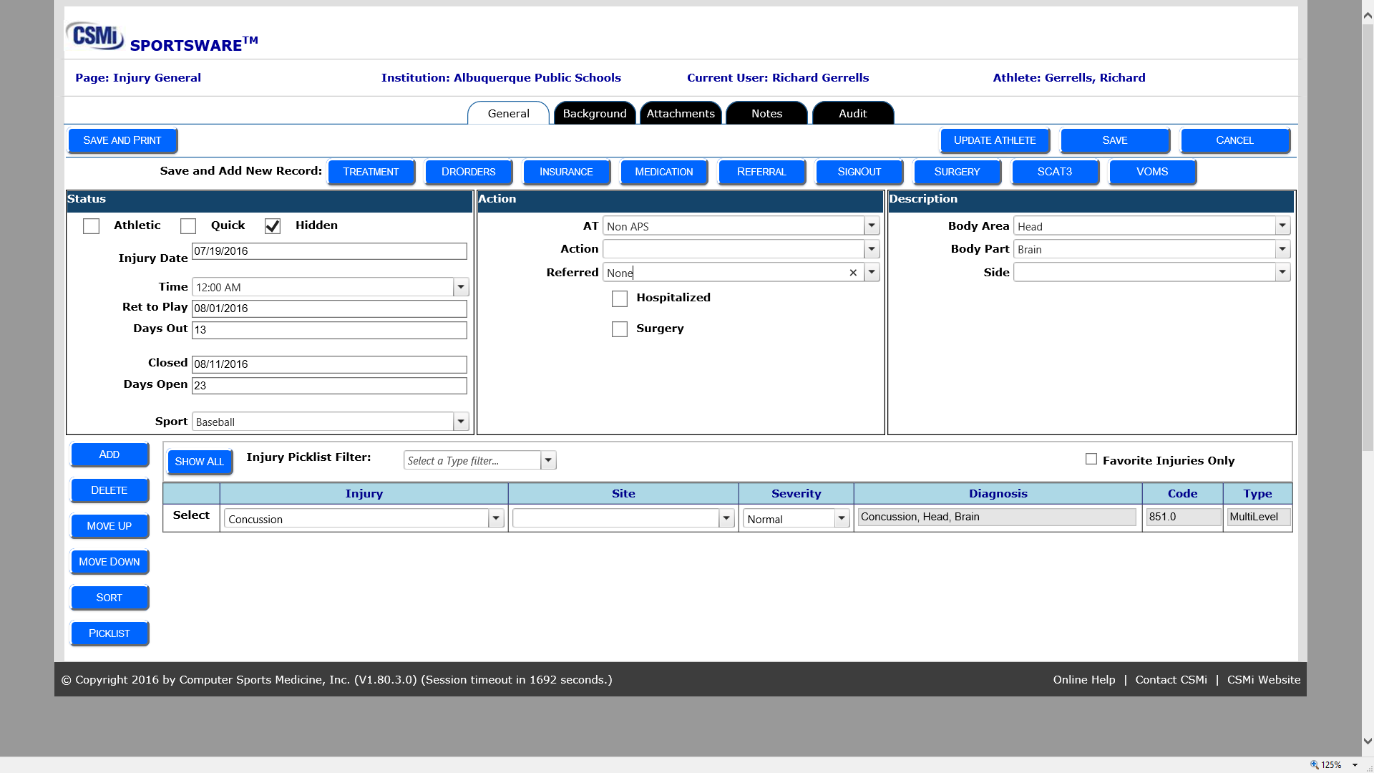

Slide 47
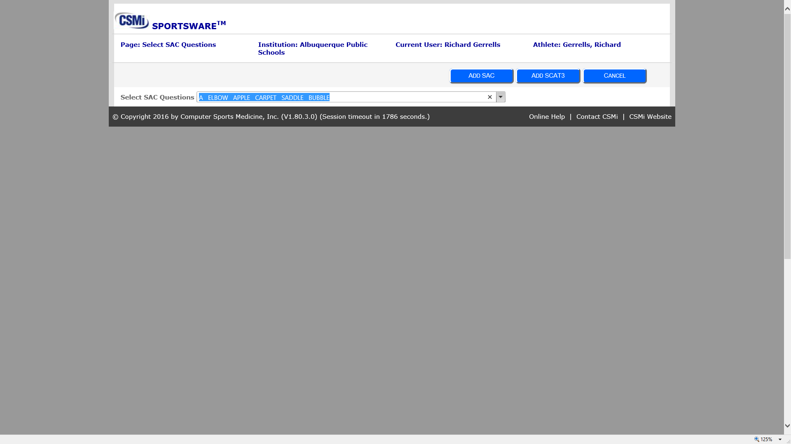

Slide 48
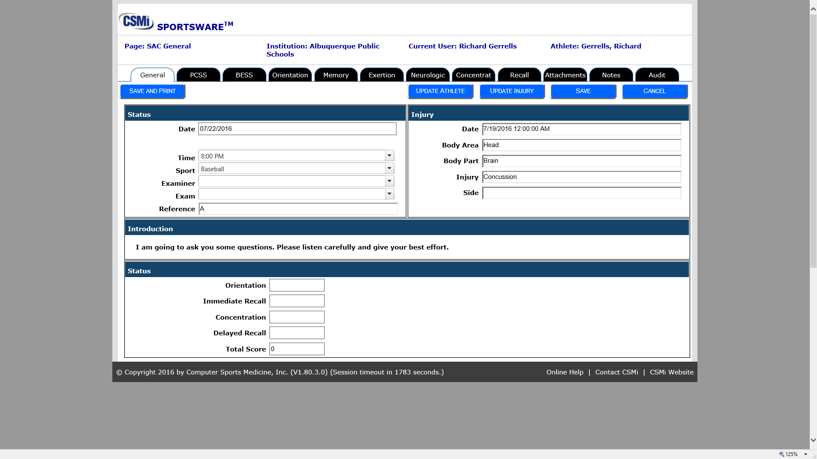

Slide 49
APS Athletics
Exam
Baseline Not required can be used as you desire
Injury All Concussion must have SAC completed at this stage in SWOL
Post Game As needed
Step 1 Asymptotic (Symptoms are minimal and class activity normal)
Step 2 Light Exercise (Bike, walking, etc.)
Step 3 Moderate Exercise Jogging to running increase bike some agility
Step 4 High Exercise Agility head movement etc.
Step 5 Full contract workout
Step 6 Full Return to play
Symptom Score To be used when testing but not increasing to next step level
Post injury Eval To be used for final check week or two after injury to assure continued clear performance.

Slide 50
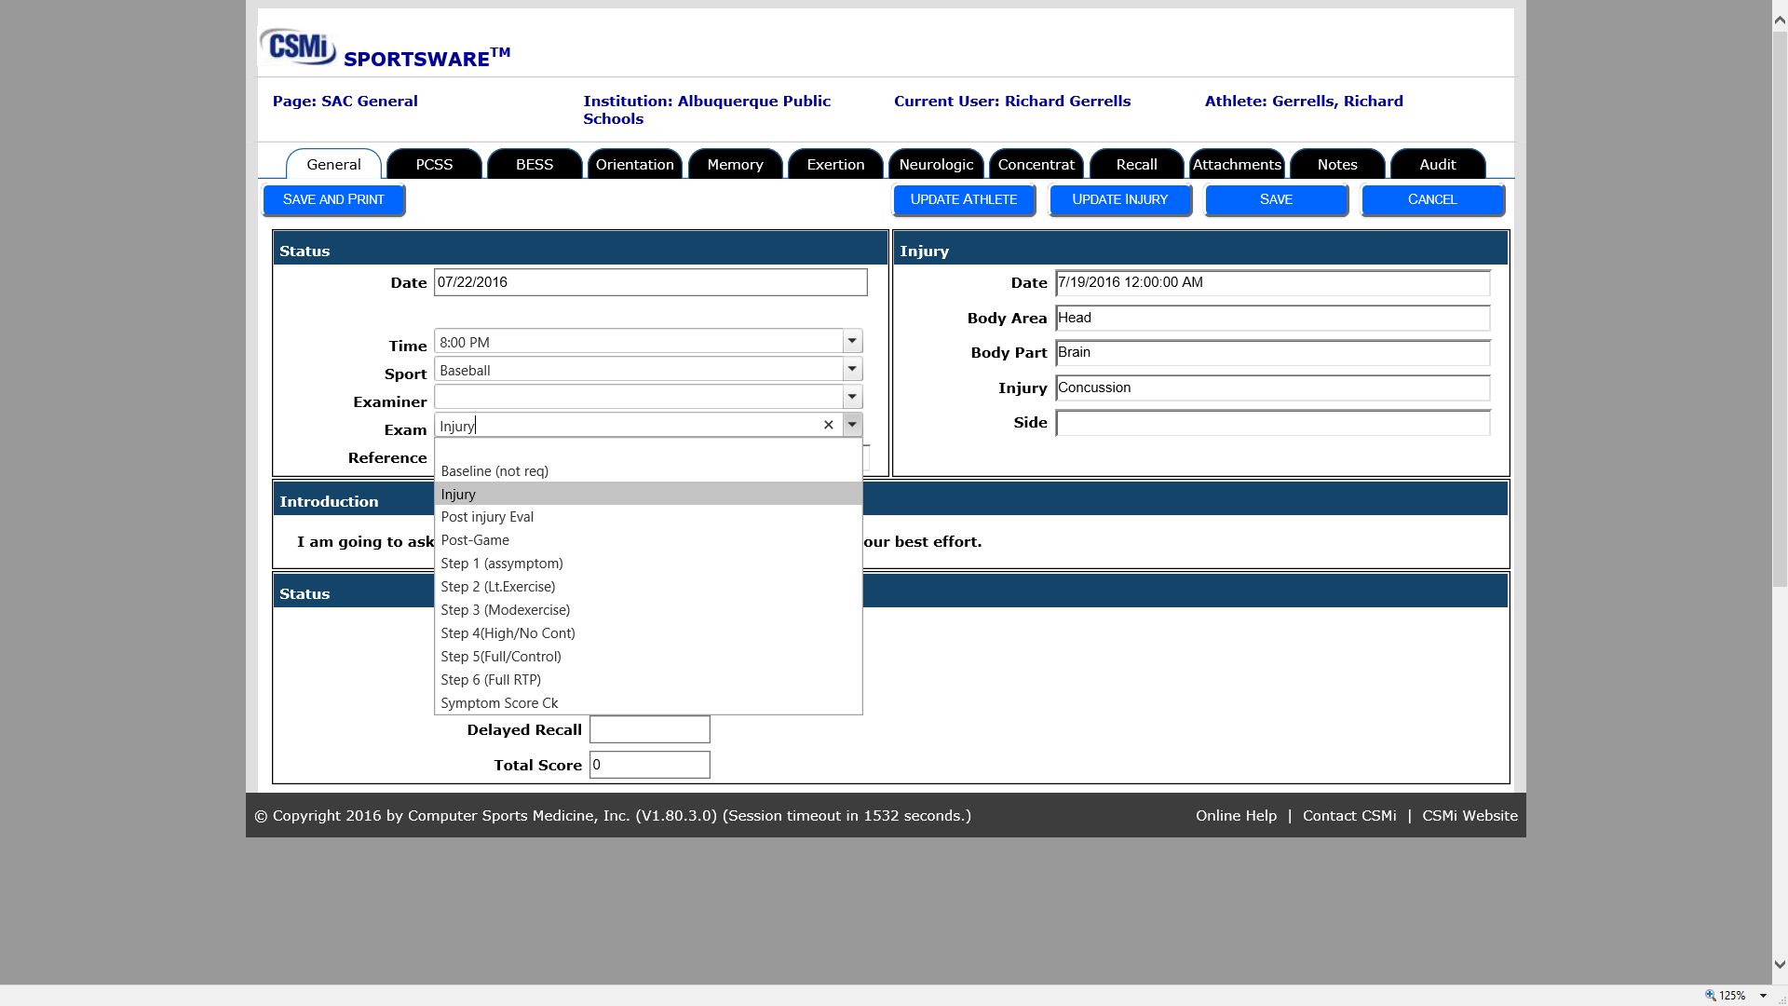

Slide 51
APS Athletics
Complete concussion evaluation information:
Post Concussion Symptom Scale
Balance Error Scoring
Orientation
Memory
Exertion
Neurologic
Concentration
Recall
Notes

Slide 54
APS Athletics
Option 2 SWOL Only
Database is utilized for recording each day progression
Initial Injury with full evaluation
Progression of recovery at least as each step is completed.
Notes can be added as needed.

Slide 55
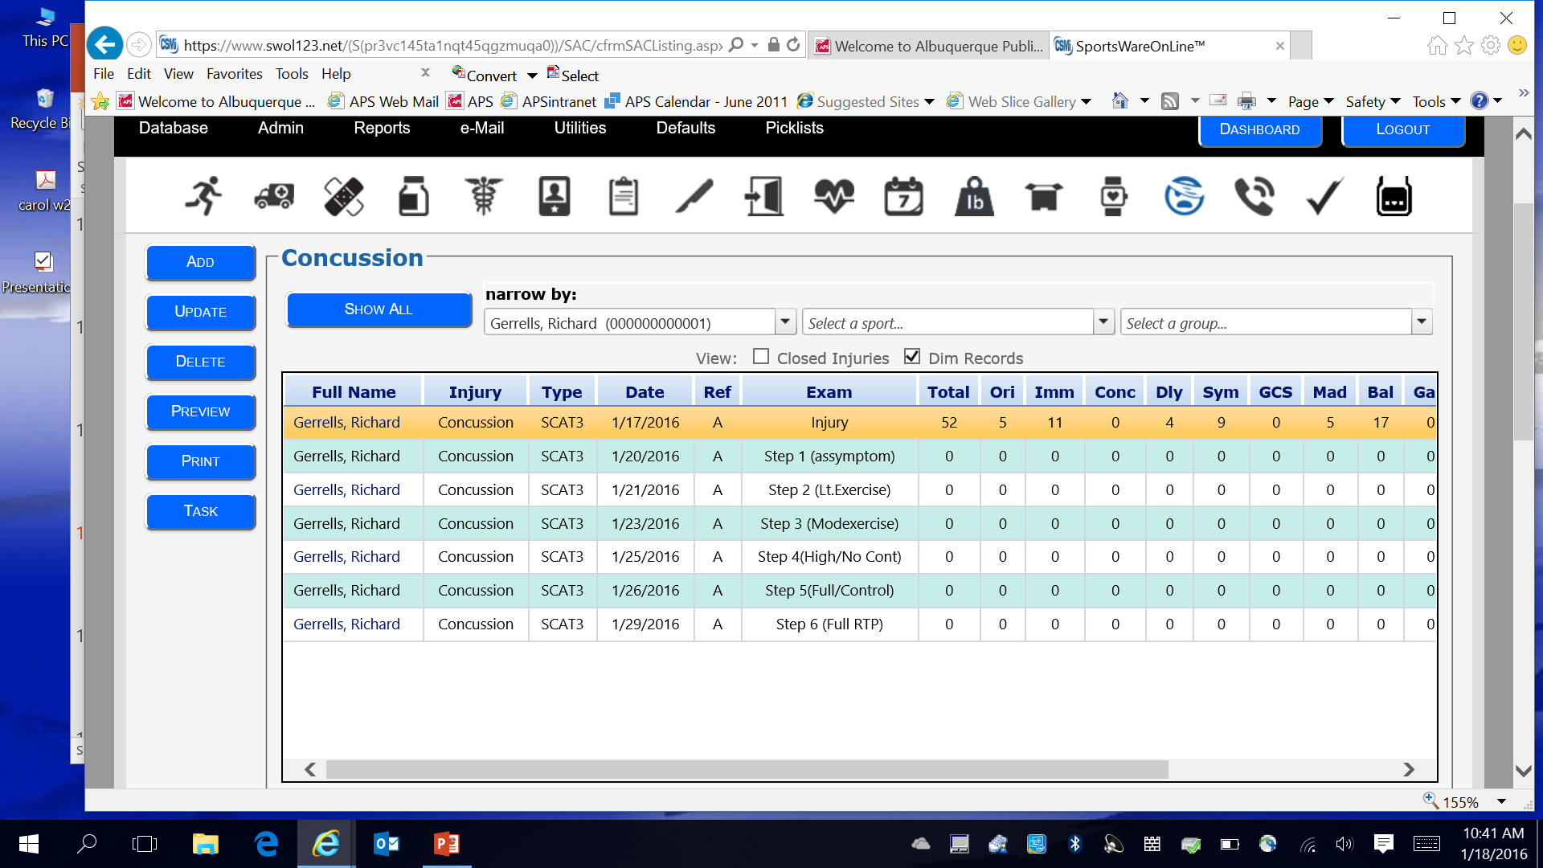

Slide 56
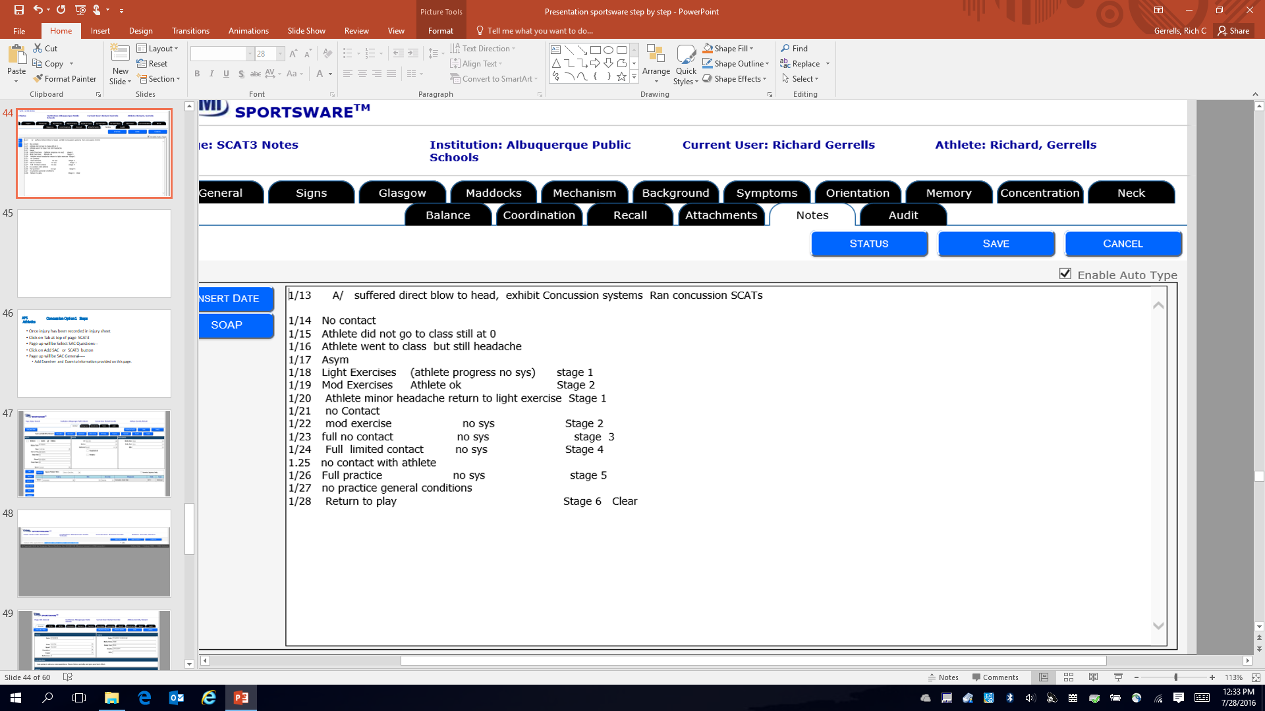

Slide 57
APS Athletics
Concussion Option 2 Steps
Click on injury icon
Find athlete ( school data base) Highlighted athlete
New injury click add--- Injury already recorded click on update
Once injury established:
Click on SCAT3 Tab---Concussion detailed information occurs
Click on SCAT 3 or SAC enter all information you gather.
Complete information as needed for current session.
Always Save information you have added.
Updates can occur from either Injury icon or Concussion Icon

Slide 59
APS Athletics
All cases: Establish the date that athlete returns to play
Return to play--- Timeline would be the date that the athlete went back to full activity.
On going rehab may still be going on
Limits may be in place as to how much full activity etc.
Closed
Closed no more treatment—observation—care is required for athlete.
Athlete does not return
Athlete chooses due to injury or other issues not to return to activity
Contact with parents should be attempted. (Record of attempt noted in note section)
Athlete is then marked as case closed.

